Slide 1
Antiretroviral therapy and women’s health.
Dr. Claudia Cortés M.
Associate professor
Universidad de Chile
ccortes@fundacionarriaran.cl

Slide 2
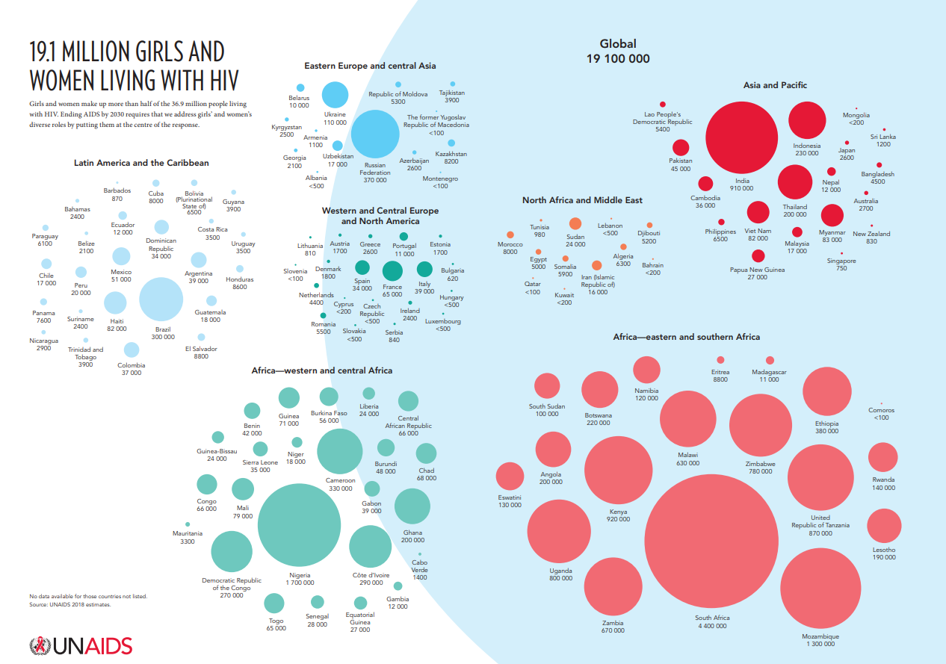

Slide 3
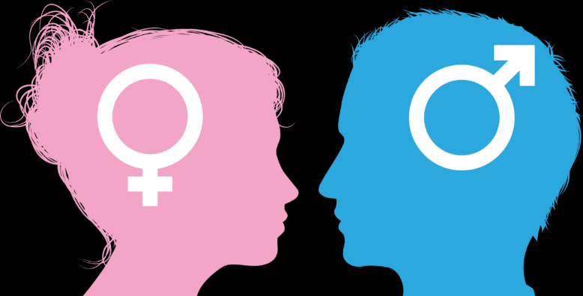
Are women really different from men?

Slide 4
YES…. In so many many ways…
Just from the HIV perspective:
Pathogenesis
HIV reservoir
PK-PD
Participation in trials
Social Factors

Slide 5
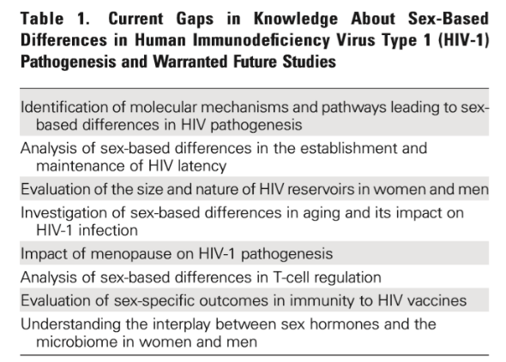

Slide 6
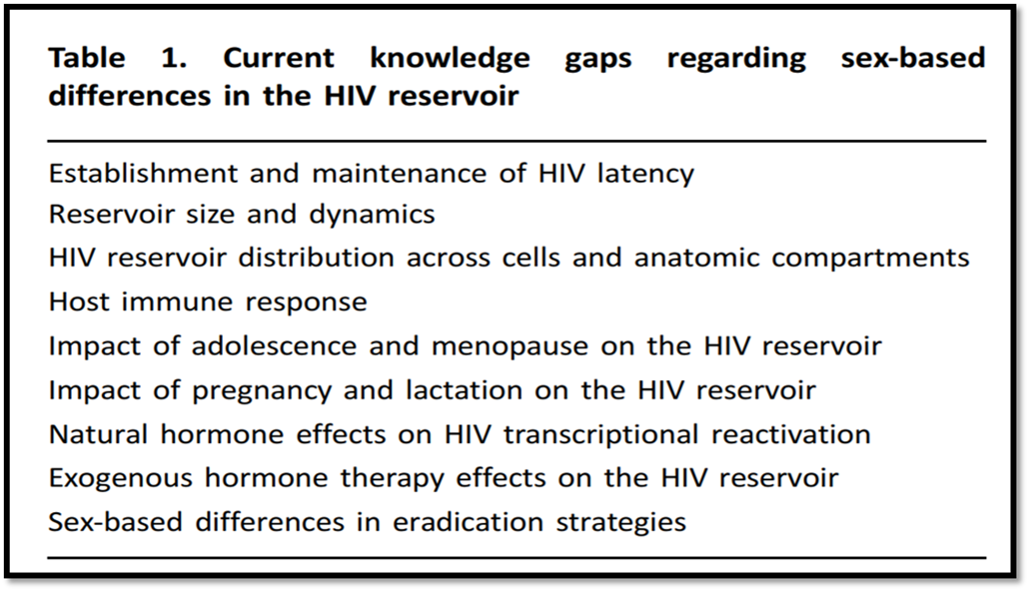
Barriers to a cure for HIV in women
Gianella S et al.
J Int AIDS Soc. 2016; 19(1): 20706

Slide 7
Sex Differences Relating to HIV Treatment and Disease Progresssion.
Female sex is associated with:
Lower HIV viral load (JAIDS 2002;31:11-19)
Higher CD4+ count (AIDS 1997;11:1071-3)
More pronounced immune and vaccine responses (JAIDS 2011;57:9-15)
Higher levels of immune activation (JID 2013;208:830-8)
More frequent ART side effects and discontinuation (J Antimicrob Chem 2007; 60: 724-32)

Slide 8
Conclusions
Women and men potentially differ in the course of their HIV infection, their response to treatment and drug pharmacokinetics, all of which are compounded by social and behavioral factors
Conclusions
Gender inequalities in the response to cART are mainly explained by the different prevalence of socioeconomic characteristics in women compared with men.
Conclusions
It is essential to understand sex differences in drug response, as they may affect drug safety and effectiveness.

Slide 9
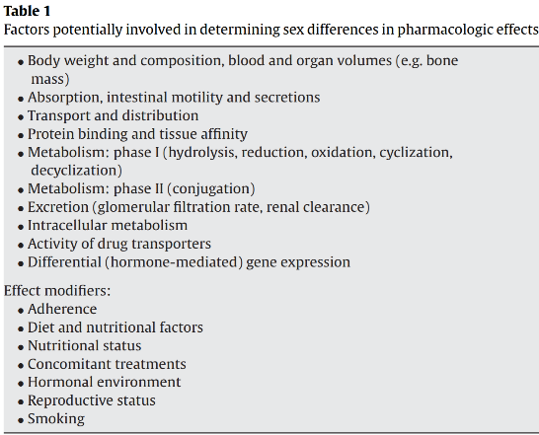
Sex Difference Considerations in ART
In general, studies have not shown sex differences in virologic responses to ART.
There are limited data showing that
pharmacokinetics for some ARV drugs
may differ between men and women,
possibly because of variations in factors
such as:
Gender differences in the treatment of HIV infection.
Pharmacological Research 58 (2008) 173–182

Slide 10
Clinical Case
Camila, 26 years of age
A journalist
Recently diagnosed after blood donation
After extensive counseling baseline lab test are done:

Slide 11
Lab tests:
HBsAg negative
Total anti-HBc negative
HCV negative
RPR (1/8)
TST negative
HIV Viral load 83,000 cps/mL
CD4 385 cels/mm3
Normal physical examination
Medication:
Levothyroxine 50 mcgr
Nuvaring (etonogestrel/ethinyl estradiol)
Multivitamins
Habits:
Vegetarian
Marihuana once or twice a month
Ecstasy (twice in her life)
Currently single

Slide 12
What general considerations are important with this patient of childbearing age?
Discuss childbearing intentions with all women of childbearing age and reassess frequently
Preconception care
Prevention of unintended pregnancies
Evaluation of effective and appropriate contraceptive methods
Optimization of women health (prior pregnancy/or not)
Include information on safe sex, restriction of alcohol, illicit drugs and smoking
Prevention of HIV transmission to an uninfected partner
Prevention and treatment of other STDs

Slide 13
What are the main considerations in relation to ART in Camila?
Choice of individualized ART, considering:
Previous history of ART
Known resistance patterns
Adverse effects and toxicities
Optimize adherence
Probable effects on a possible fetus-newborn
In agreement with the patient: FTC/TDF + DTG was prescribed

Slide 15
Monday 22 July
14:30-16:00
Sala A

Slide 16
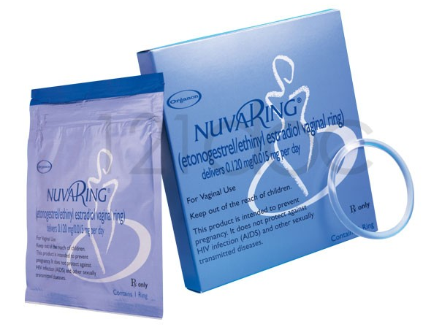
Camila wants to be sure that the vaginal ring is effective. Is it?
What are the interactions we need to be aware of?

Slide 17
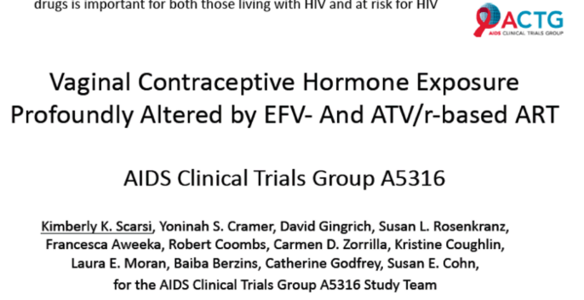
EFV based ART decreased EE by 53-57% and ENG by 76-79%
EFV based ART may decrease the effectiveness of vaginal ring contraceptive
ATV/r based ART decreased EE concentration 29-35%, but increased ENG concentrations by 71-79%
ATV/r based ART is unlikely to impact the effectiveness of vaginal ring contraceptives

Slide 18
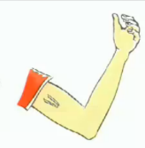

Slide 19
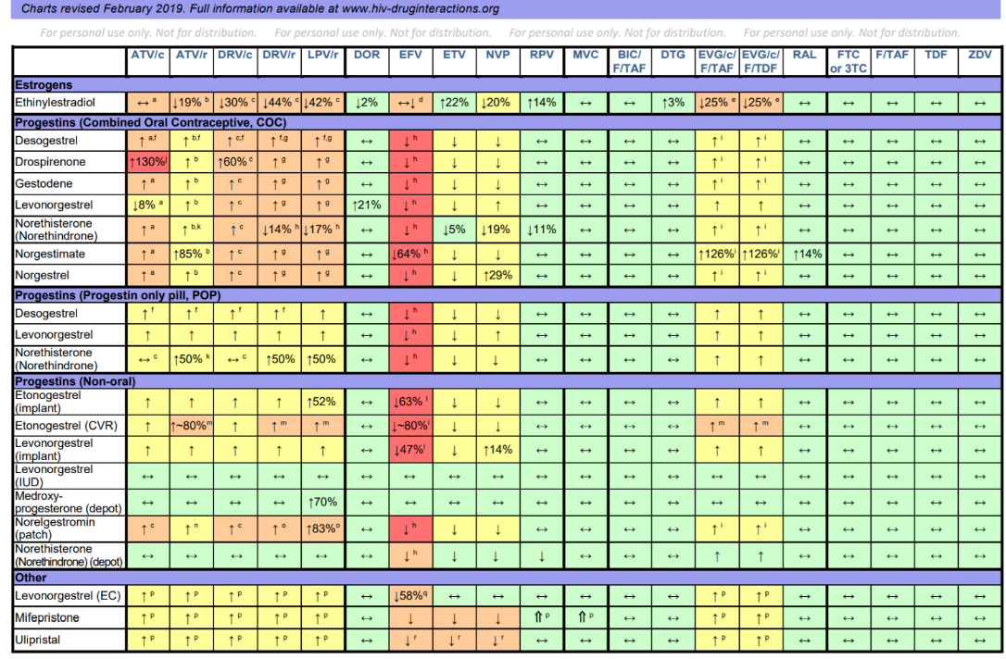
Camila wants to be sure that the vaginal ring is effective. Is it?

Slide 20
Be careful with
emergency contraception
Infect Dis Obstet Gynecol 2012 ID137192

Slide 21
What about Camila´s use of recreational drugs?

Slide 22
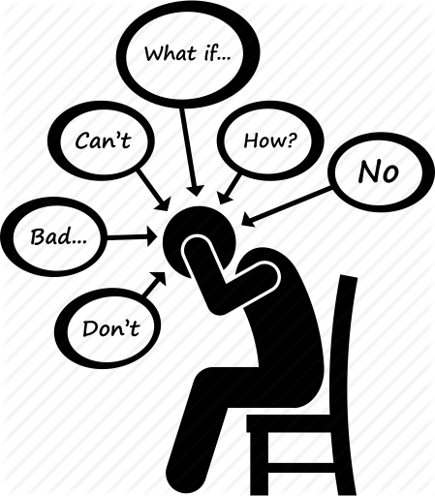
After a few months Camila complains of sleeping difficulties and emotional instability
She was evaluated by a mental health unit: adaptive disorder and first episode of depression
She is concerned about the role of the ARV in this depression diagnosis
Should she be?
Should she be?

Slide 23
Depression & HIV
Depression is the most common neuropsychiatric complication in HIV-infected patients and may occur in all phases of the infection
Compared to the general population and comparable HIV seronegative subjects, the prevalence of clinical depression is two- to fourfold higher in HIV + individuals
As in the general population, gender is considered a risk factor for depression, with females being at increased risk
Curr Psychiatry Rep (2015) 17:530

Slide 24
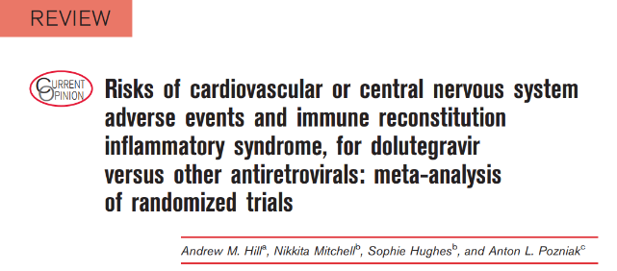
Conclusions: Analysis of 3 different data sources shows that, similar to other frequently prescribed anchor, psychiatric symptoms are also reported in DTG-treated patients.
These events are reported with low frequency and rarely necessitate DTG discontinuation
J Acquir Immune Defic Syndr 2017; 74: 423-431
Curr Opin HIV AIDS 2018; 13: 102-111

Slide 25
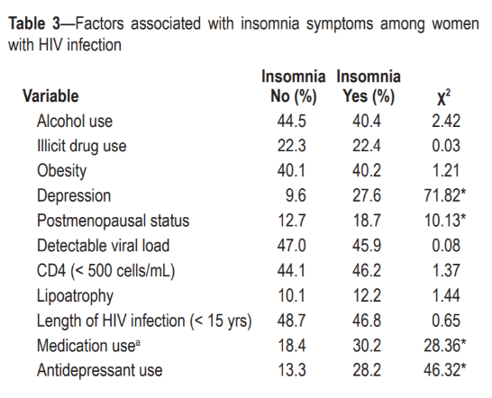

Slide 26
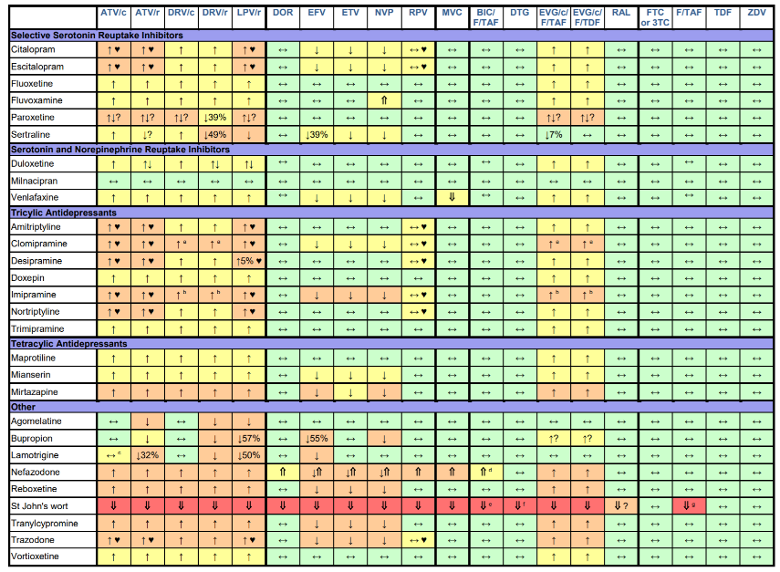

Slide 27
What about Camila’s Multivitamins
Multivitamins often contain divalent cations such as calcium, magnesium and Iron.
All the integrase inhibitors are affected by cation containing preparations – including multivitamins, calcium supplements and antacids

Slide 28
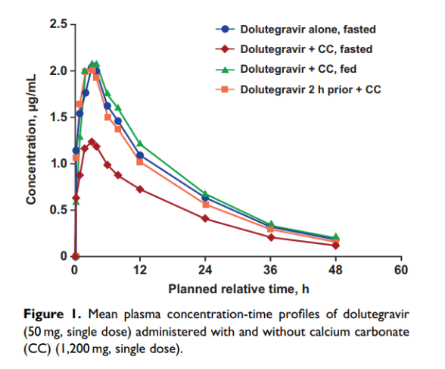
What about Camila’s multivitamins?
Mean plasma concentration-time profiles of DTG (50 mg, single dose) with and without calcium carbonate (CC) (1,200 mg, single dose).
Song I et al J Clin Pharmacol. 2015 May; 55(5): 490–496.

Slide 29
Current Recommendations in SmPC for Integrase Inhibitors and Ca⁺⁺ containing preparations
Cation | Raltegravir | Dolutegravir | Elvitegravir/c | Bictegravir
Calcium containing | No dose adjustment (bd) Not recommended (qd) | Separate well (DTG 2h before or 6h after) | Ca⁺⁺ Not specifically stated Separate by at least 4h for Al⁺⁺/Mg⁺⁺ | Can be taken together without regard to food*.
Mg²⁺
Mg²⁺
* Food reduces the impact of the cation on exposure (by ~ 30%).
Genvoya SmPC 04/19; Tivicay SmPc 04/19.; Isentress SmPC 03/19; Biktarvy SmPC 11/18

Slide 30
Don’t forget about “natural” medications and herbs

Slide 31
Results:
Women represent a median of:
19.2% participants in ART studies
38.1% participants in vaccine studies
11.1% in cure studies

Slide 33
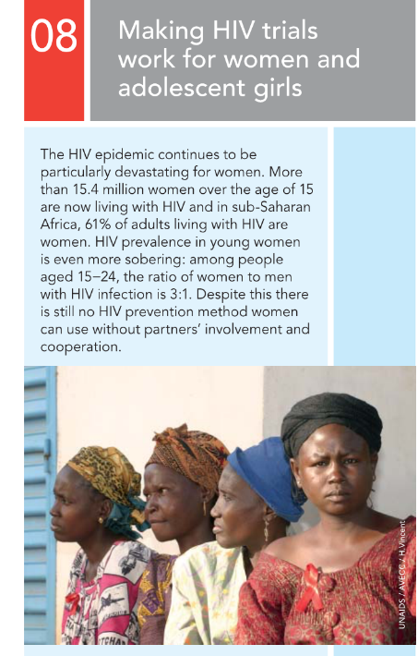
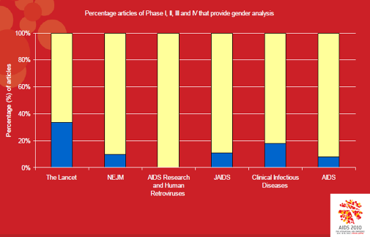

Slide 34
